Slide 1

Introduction to Deep Learning
CSCA 5642

Slide 2
IMDB Binary Text Classification
Project Description
This project uses the IMDb Large Movie Review dataset, which contains 25,000 labelled movie reviews for training and 25,000 labelled movie reviews for testing. It's a binary sentiment classification problem where the goal is to classify the IMDB reviews as positive or negative.
Main Goal of the project:
The main objective of the project is to build and evaluate deep learning models to classify whether the IMDB review is positive or negative.
I have used the following deep learning models to classify the sentiment of a review.
I have chosen the best model based on the accuracy, loss values, and F1 score, and implemented the best model on the test set. Hyperparameter tuning(using Keras Tuner) was performed for BiLSTM, CNN, and GRU models.

Slide 3
Citation
Citation:
Data Source Link: https://ai.stanford.edu/~amaas/data/sentiment/
Data Source for this project can be found in the below link:
Sentiment Analysis. (n.d.). Ai.stanford.edu. https://ai.stanford.edu/~amaas/data/sentiment/
‌ Maas, A. L., Daly, R. E., Pham, P. T., Huang, D., Ng, A. Y., & Potts, C. (2011, June 1). Learning Word Vectors for Sentiment Analysis. Association for Computational Linguistics. https://ai.stanford.edu/~amaas/papers/wvSent_acl2011.bib
‌@InProceedings{maas-EtAl:2011:ACL-HLT2011, author = {Maas, Andrew L. and Daly, Raymond E. and Pham, Peter T. and Huang, Dan and Ng, Andrew Y. and Potts, Christopher}, title = {Learning Word Vectors for Sentiment Analysis}, booktitle = {Proceedings of the 49th Annual Meeting of the Association for Computational Linguistics: Human Language Technologies}, month = {June}, year = {2011}, address = {Portland, Oregon, USA}, publisher = {Association for Computational Linguistics}, pages = {142--150}, url = {http://www.aclweb.org/anthology/P11-1015} }

Slide 4
Project Steps
Project Description and Objective
Citation
Data Loading
Exploratory Data Analysis
Data Cleaning and Preprocessing
Model Building & Interpretation
Model Summary
Conclusion
Improvements
Challenges
References

Slide 5
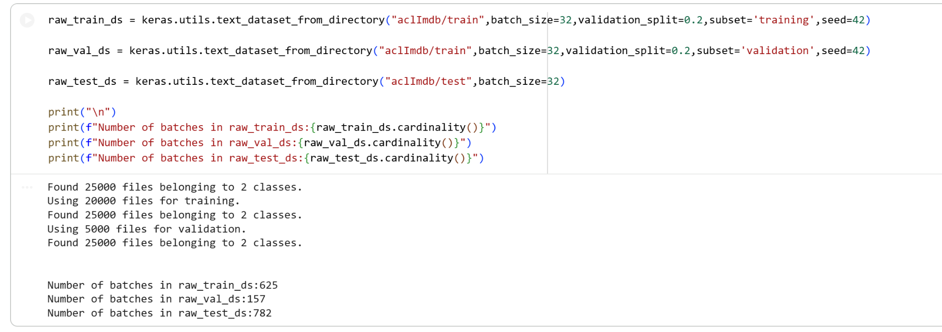
Data Loading

Slide 6
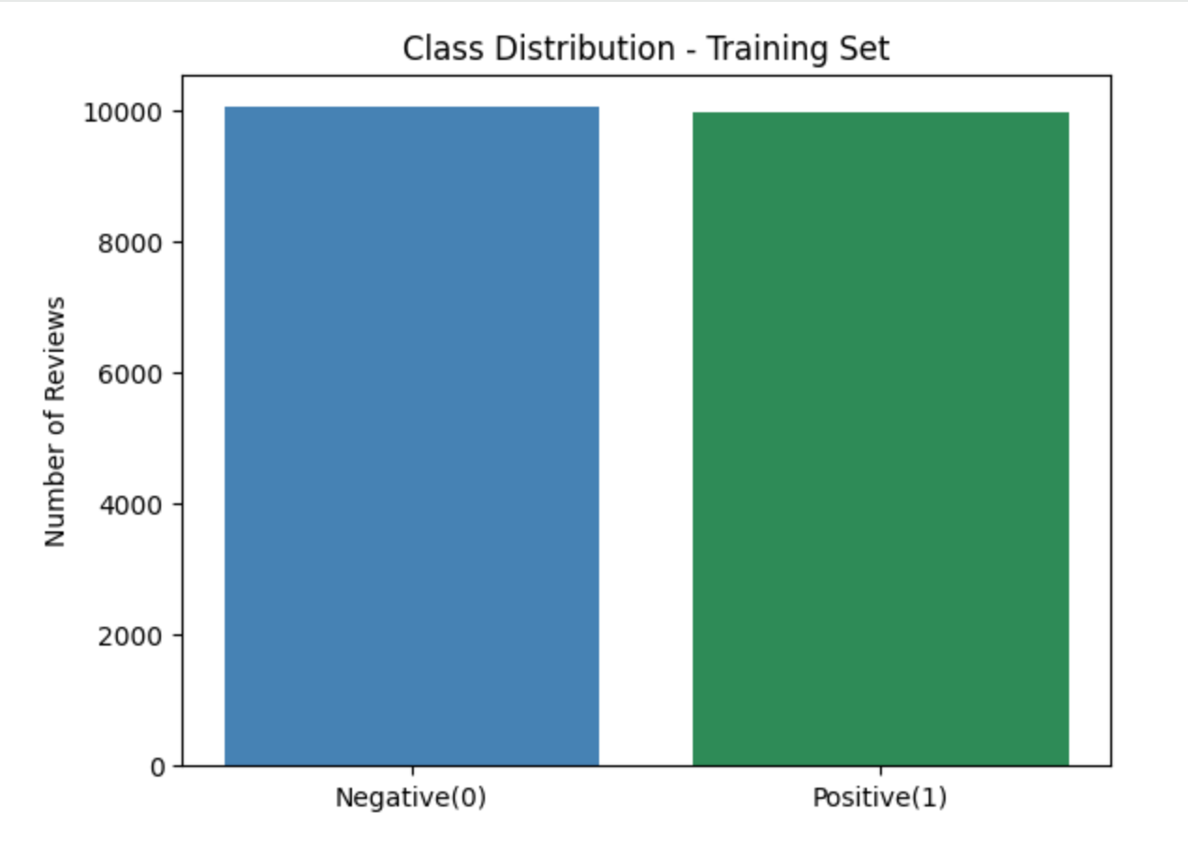
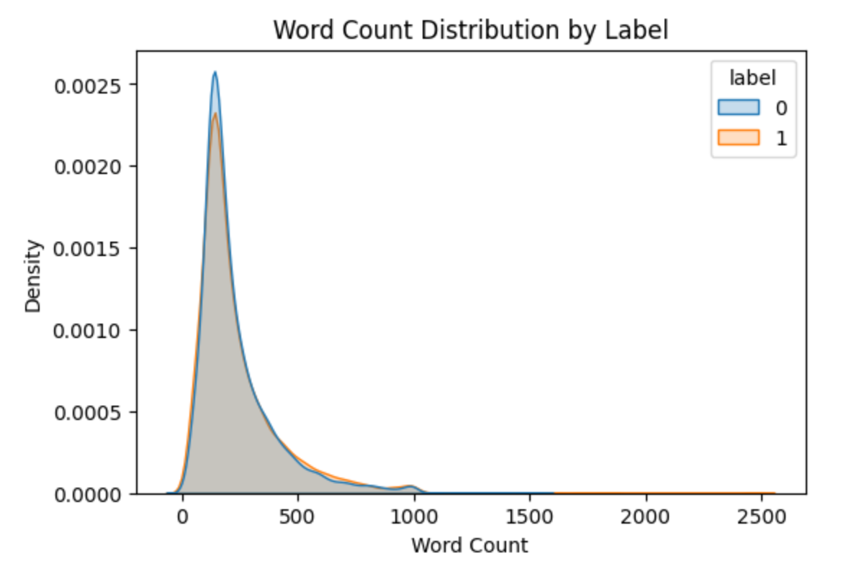
Exploratory Data Analysis
Class Imbalance & Word Count Distribution

Slide 7
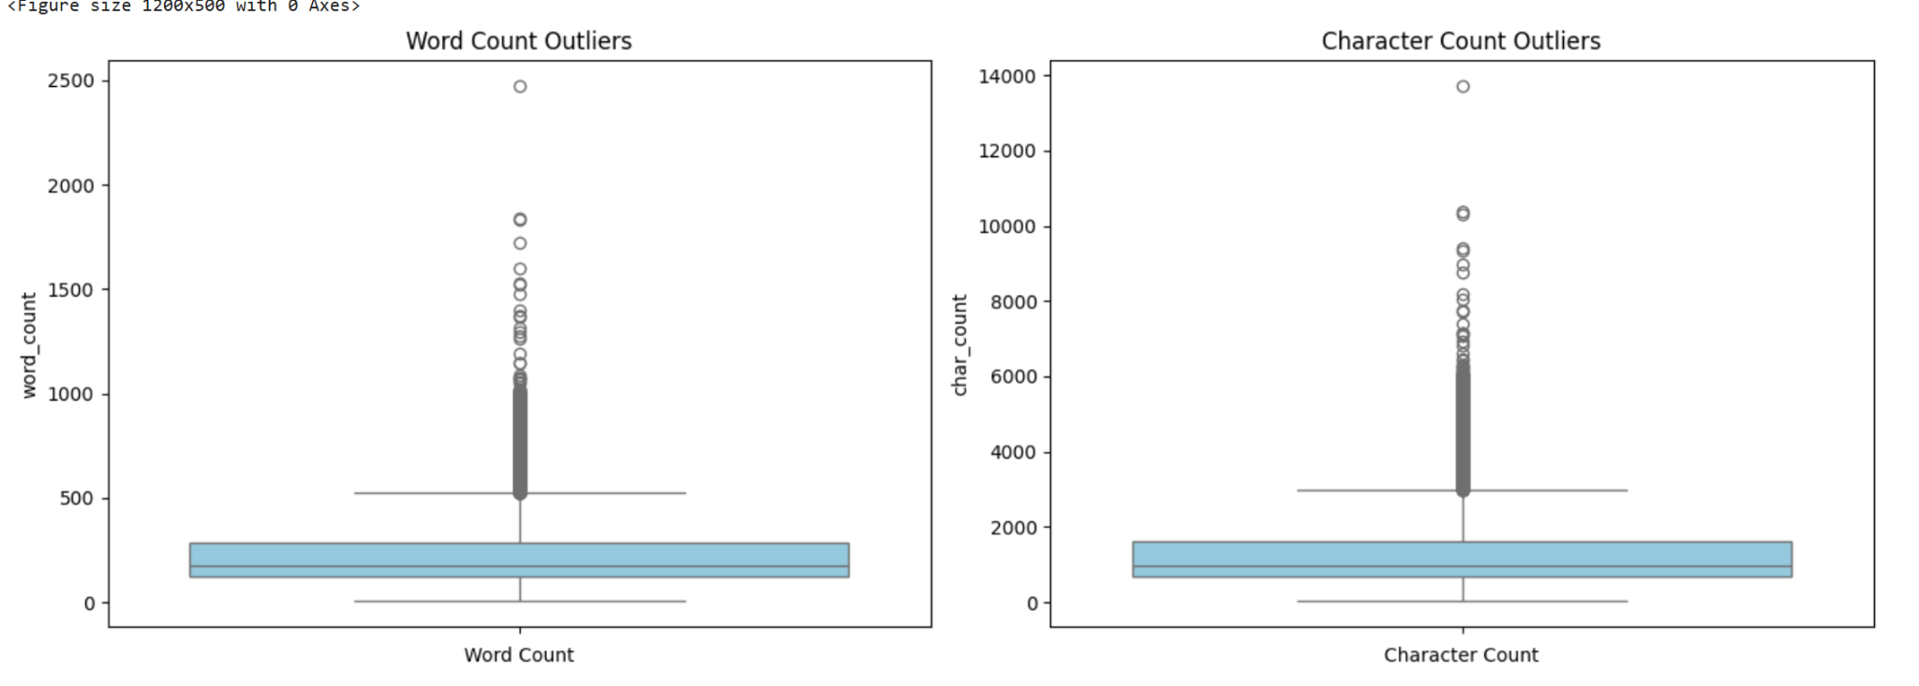
Exploratory Data Analysis
Outliers

Slide 8
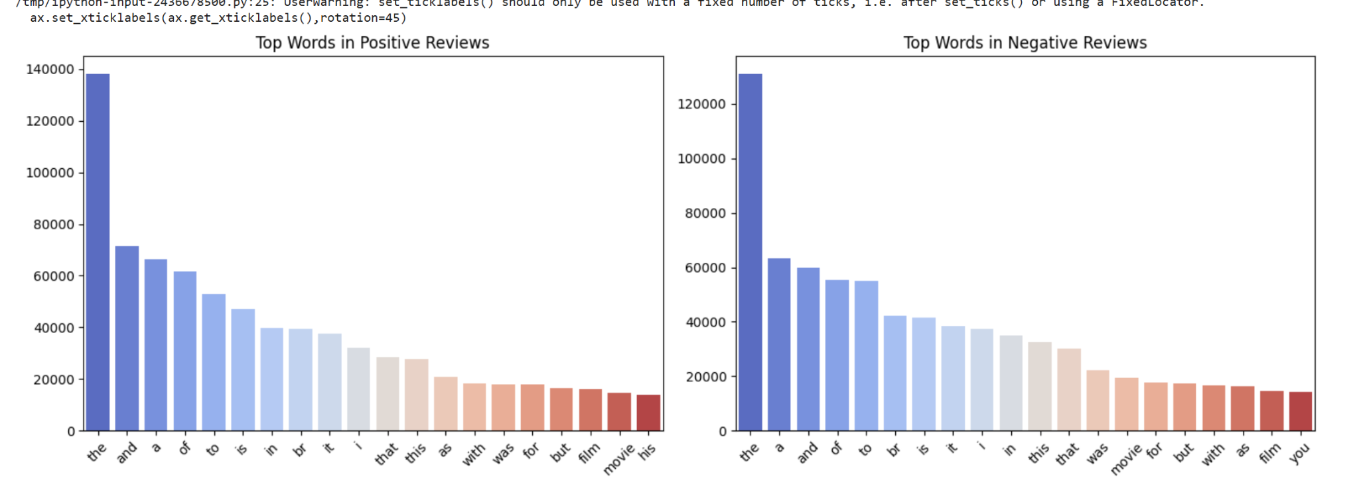
Exploratory Data Analysis
Vocabulary Level EDA

Slide 9
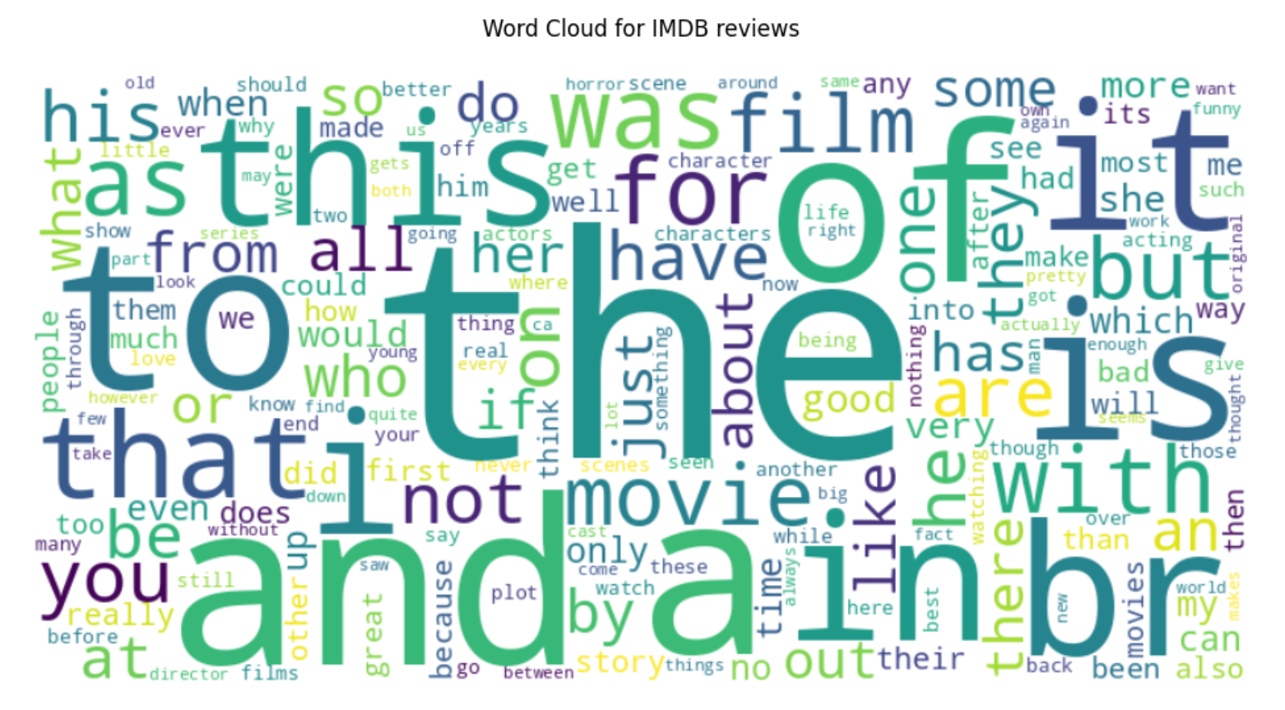
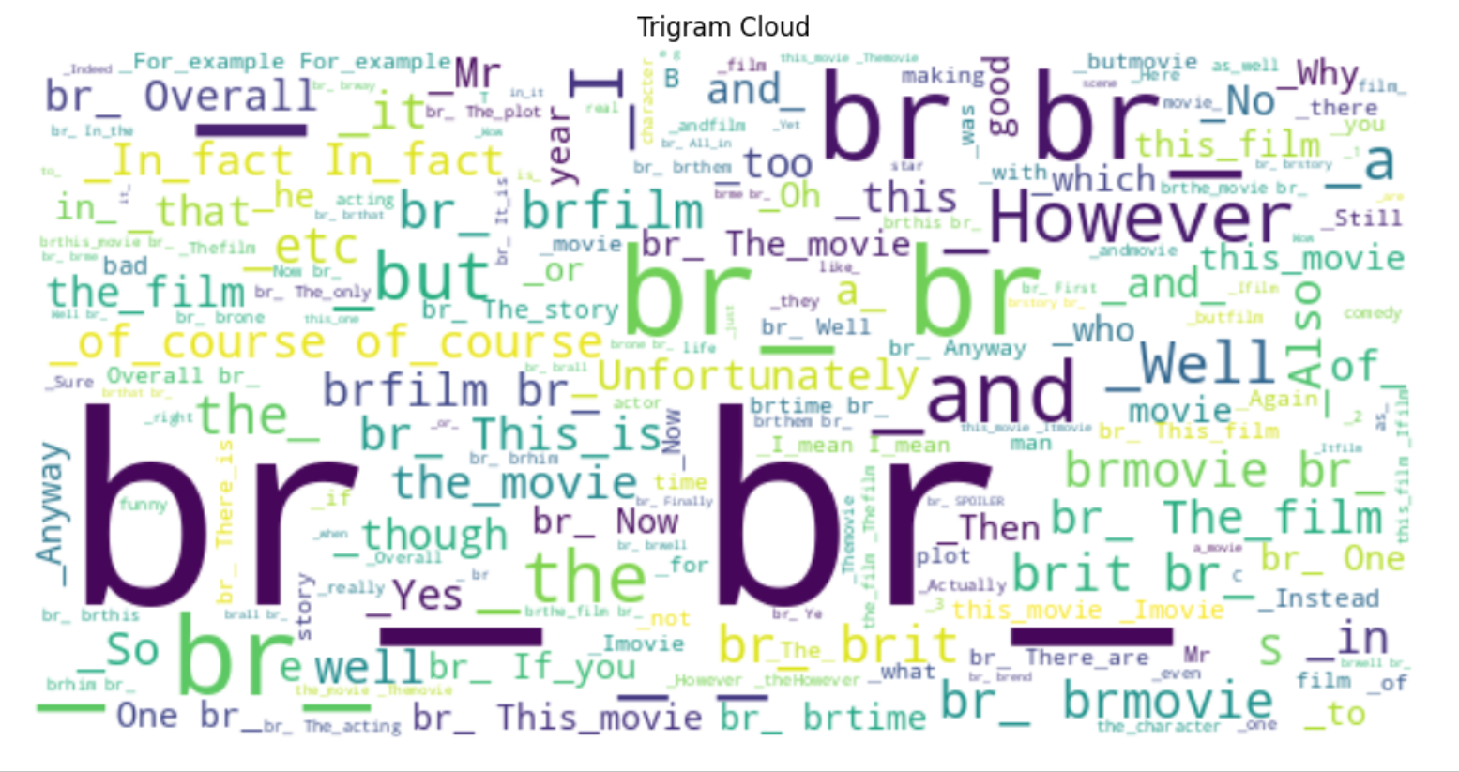
Exploratory Data Analysis
Word Cloud & N-grams

Slide 10
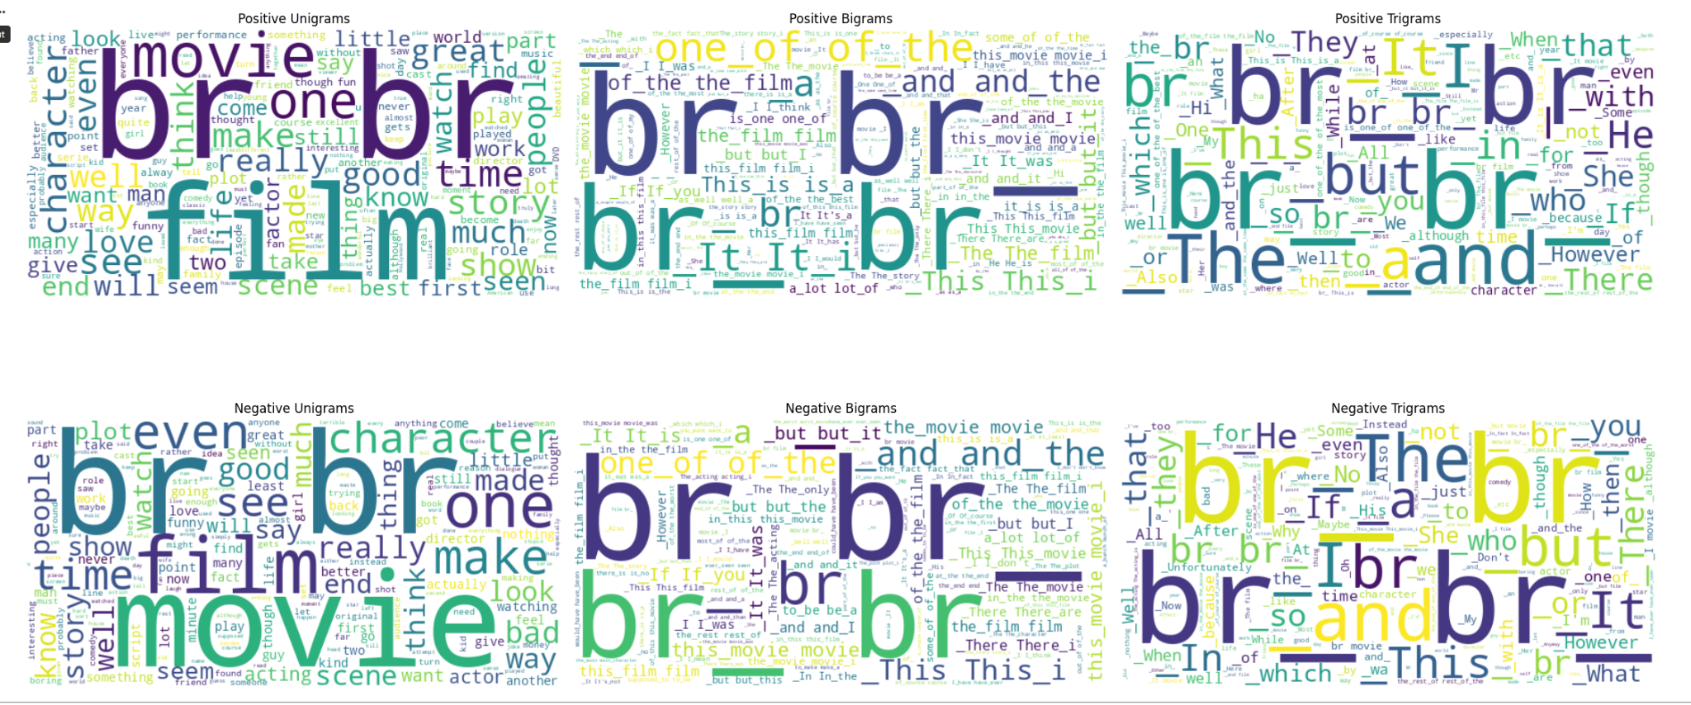
Exploratory Data Analysis
N-grams for Positive and Negative Reviews

Slide 11
Data Preprocessing & Cleaning
Converts the text to lowercase, removes HTML tags, and removes punctuation using a regex pattern
Text vectorization layer is created to convert the raw text into a sequence of integers.
Extracts only the text from the training dataset.adapt() learns only the vocabulary from the training data.
Vectorization is applied to the train, test, and val datasets.
Optimizing the data pipeline (For fastertraining - prefetching the next batch when the model trains the current batch)

Slide 12
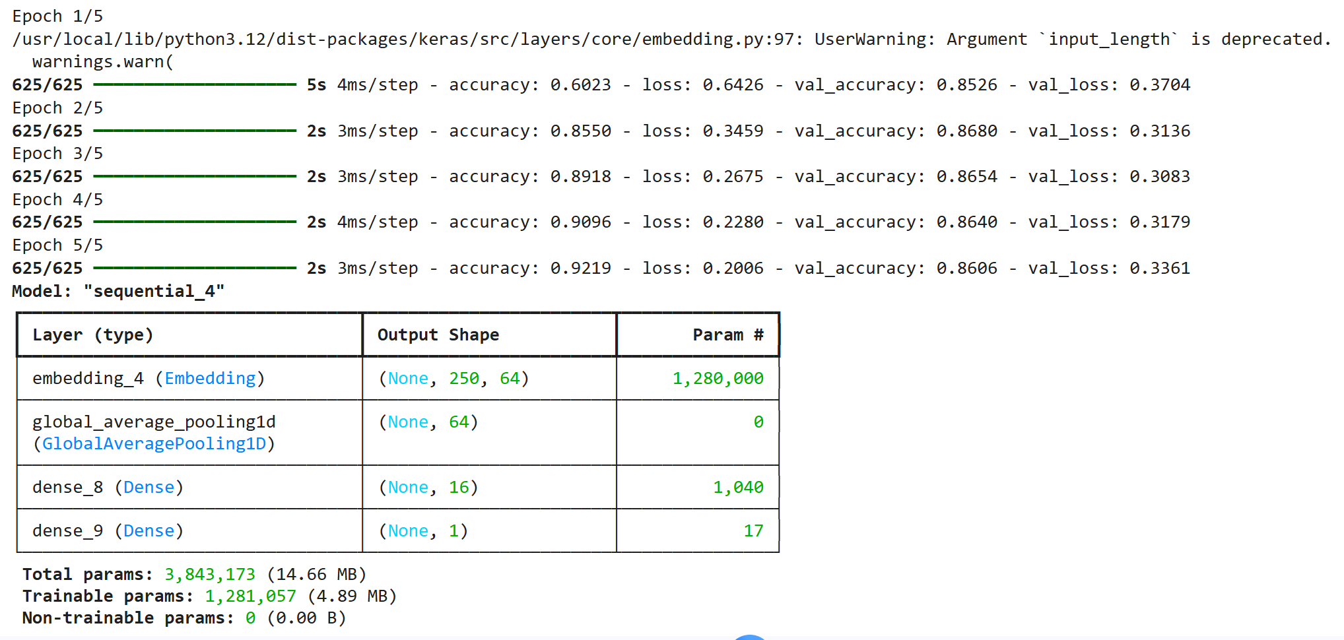
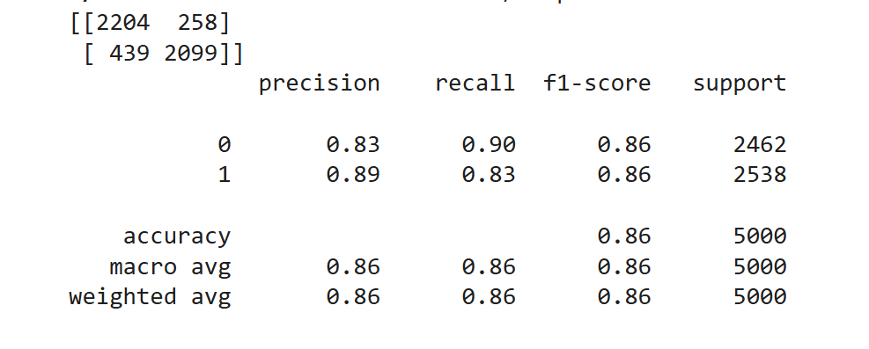
Model Building & Interpretation
Baseline Model
Place Value and Number Sense
Operations with Whole Numbers

Slide 13
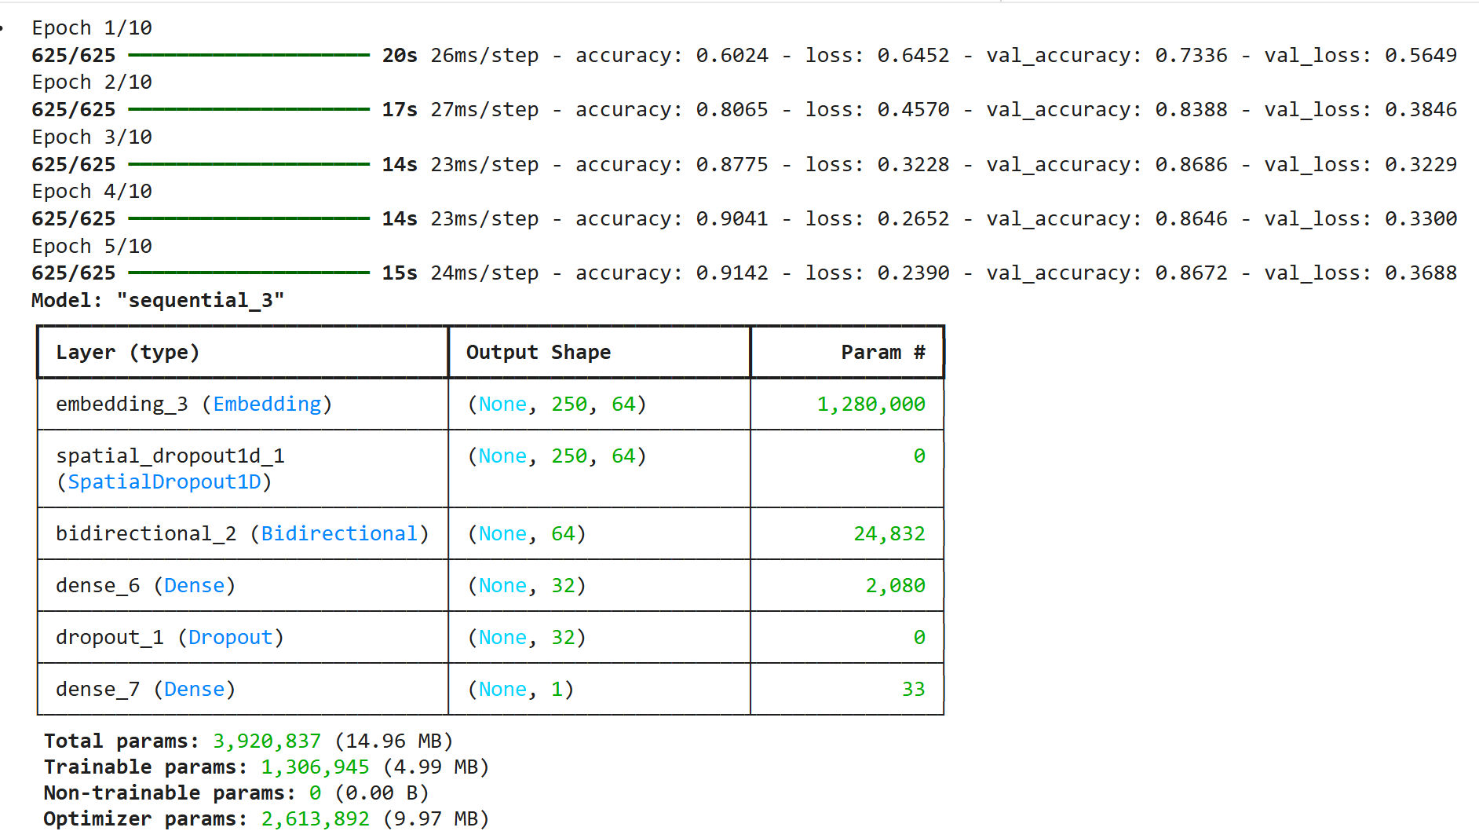
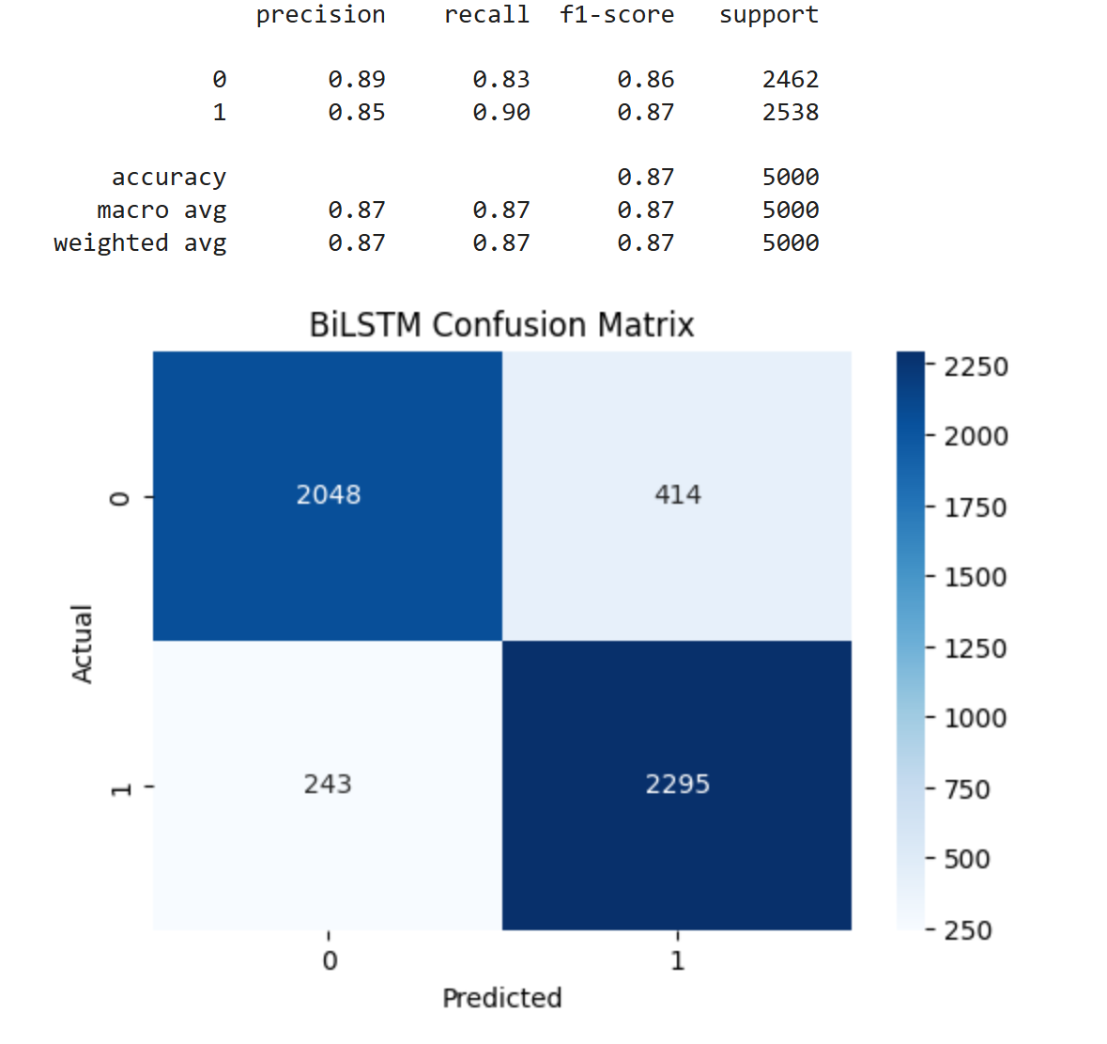
Model Building and Interpretation
BiLSTM (Standard)

Slide 14
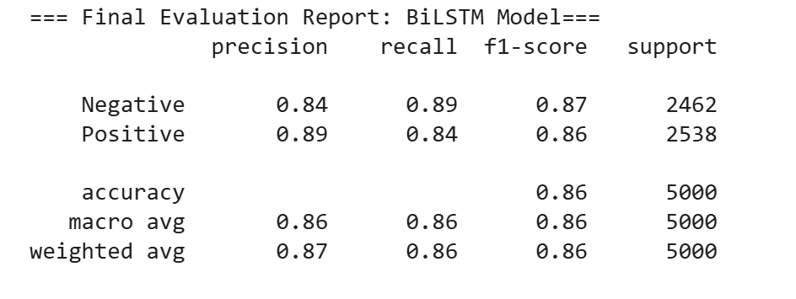
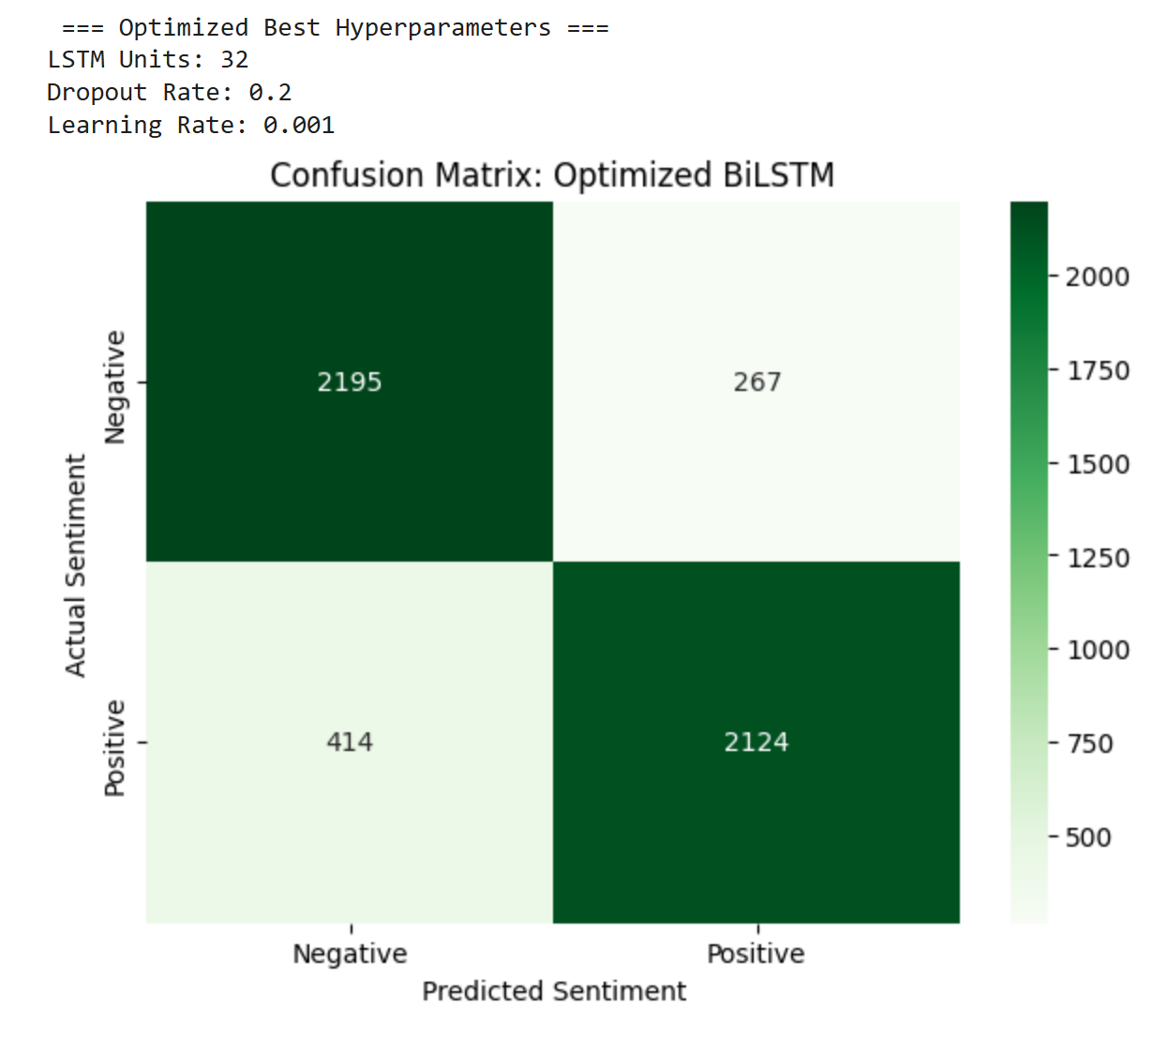
Model Building and Interpretation
BiLSTM (Tuned)

Slide 15
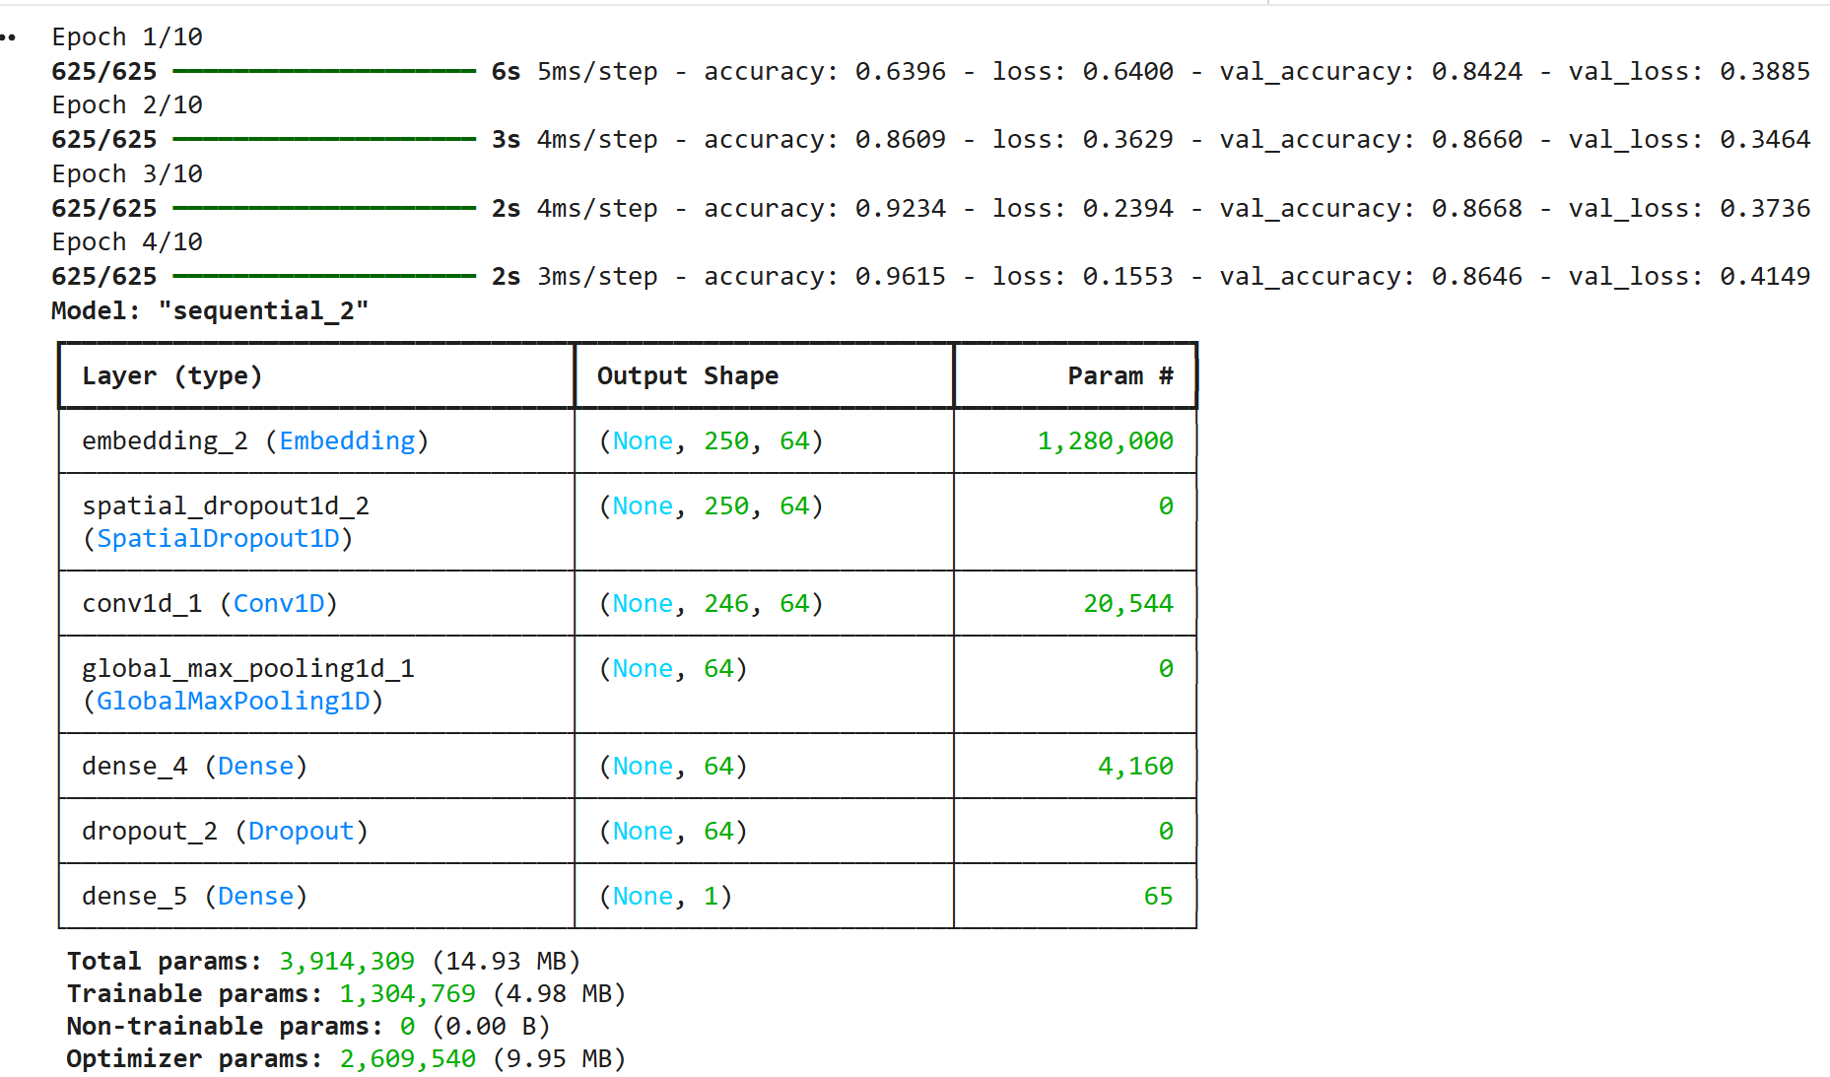
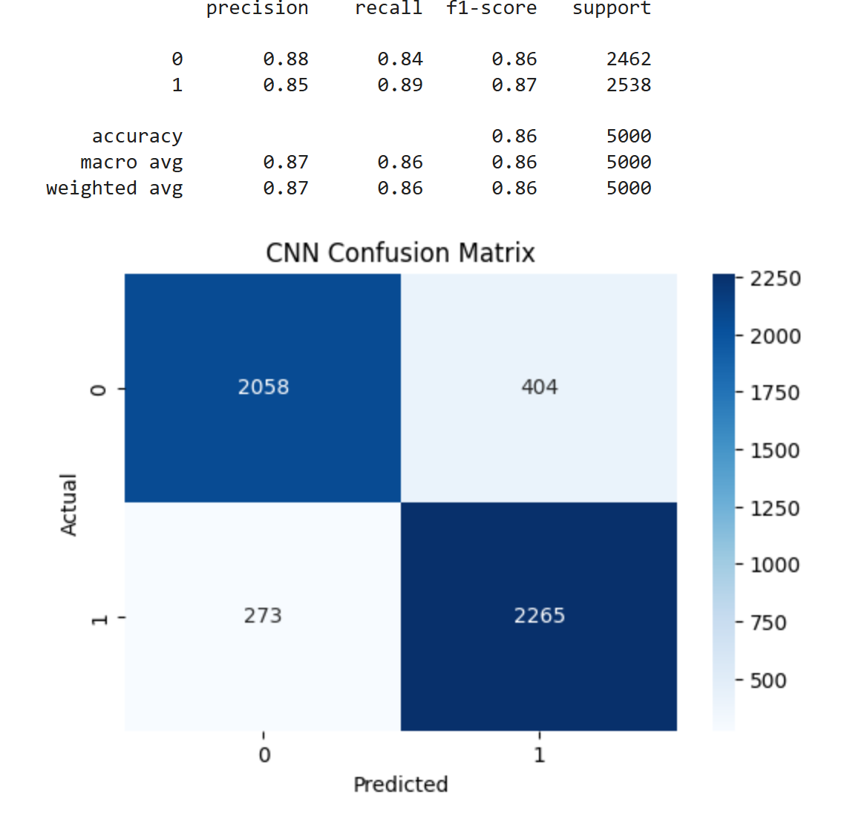
Model Building and Interpretation
1D CNN (Standard)

Slide 16
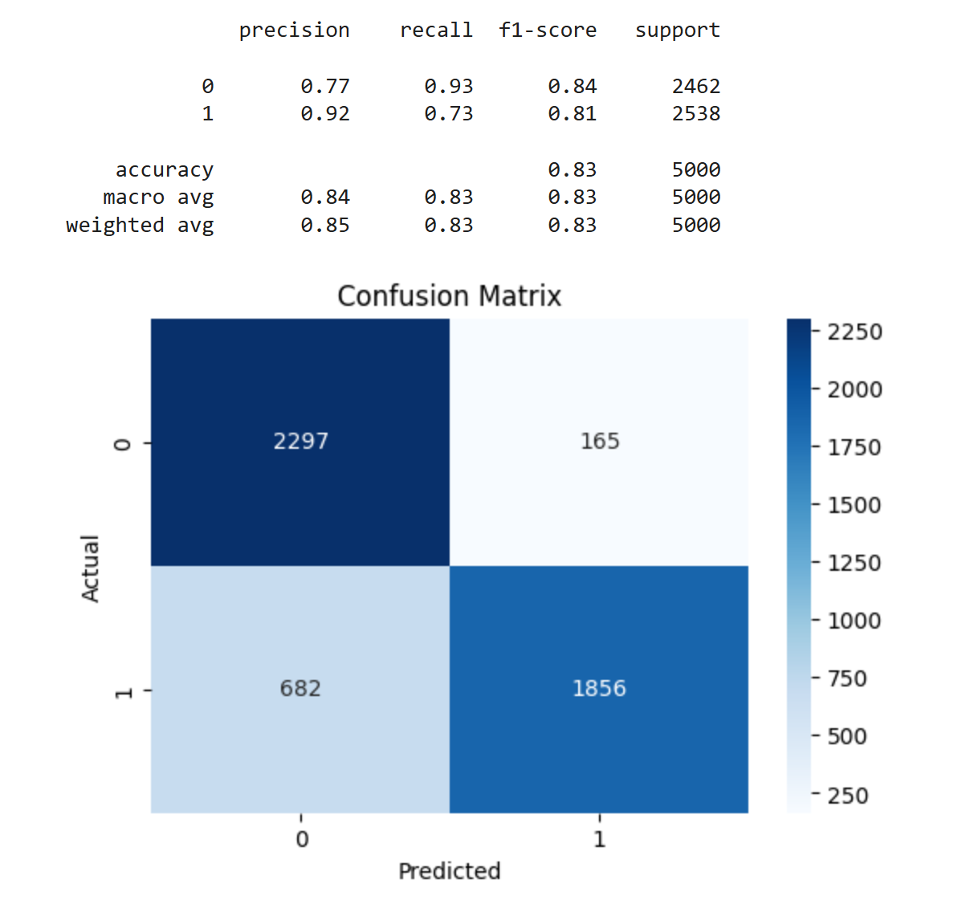
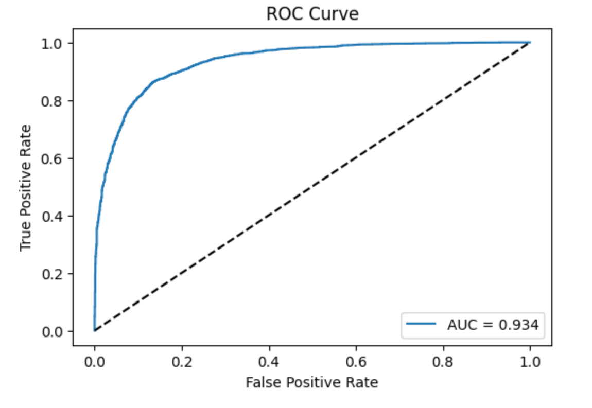
Model Building and Interpretation
1D CNN (Tuned)

Slide 17
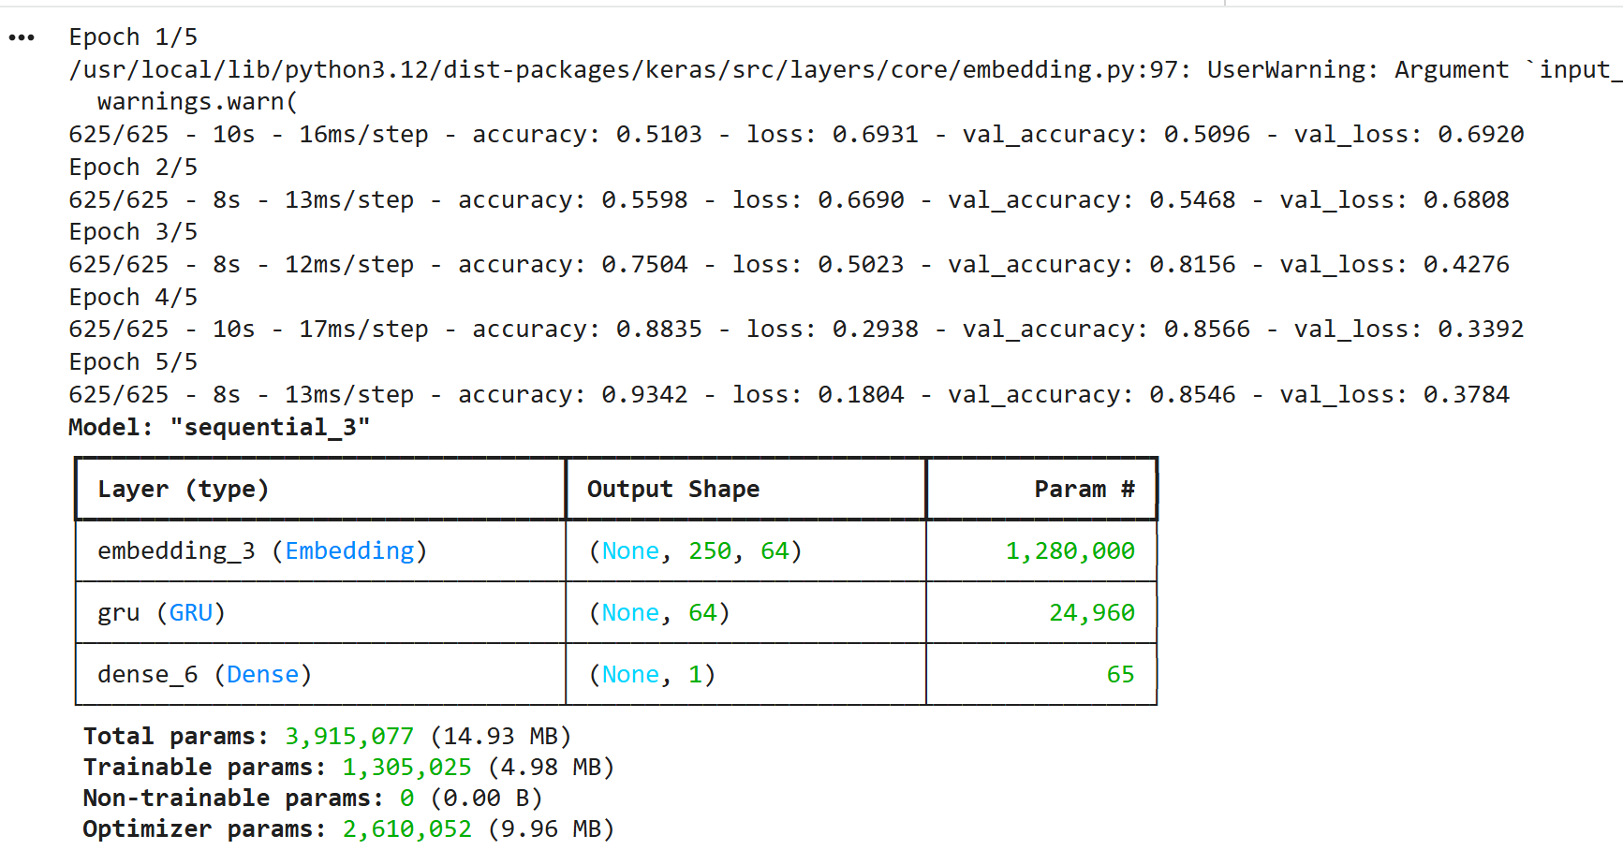
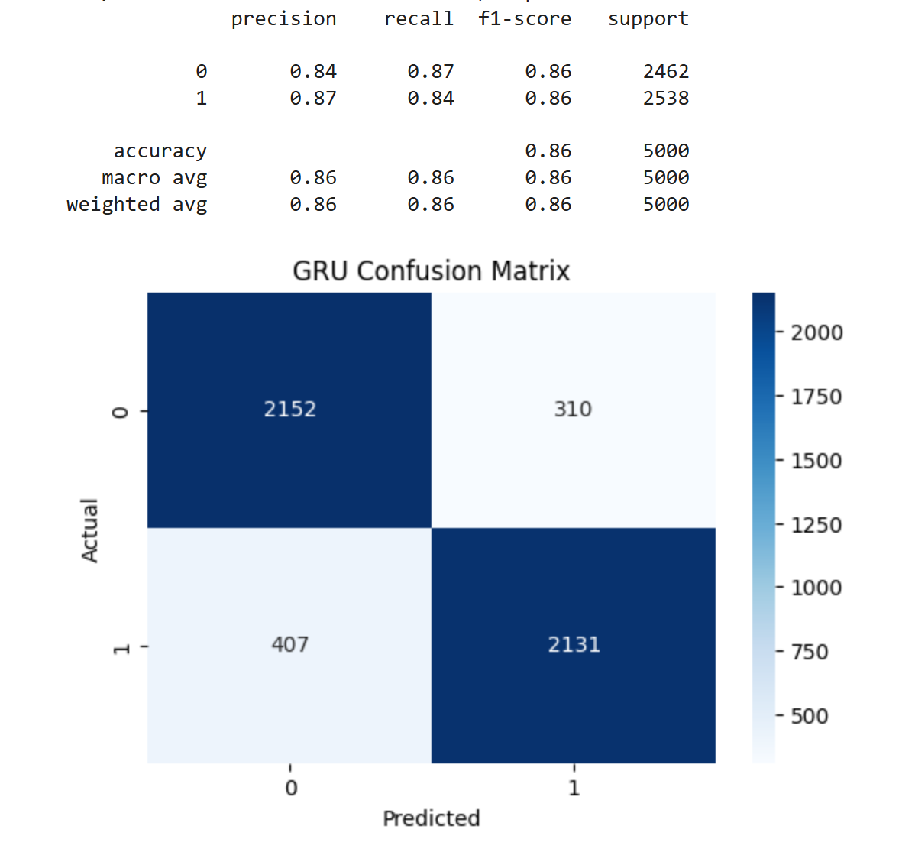
Model Building and Interpretation
GRU (Standard)

Slide 18
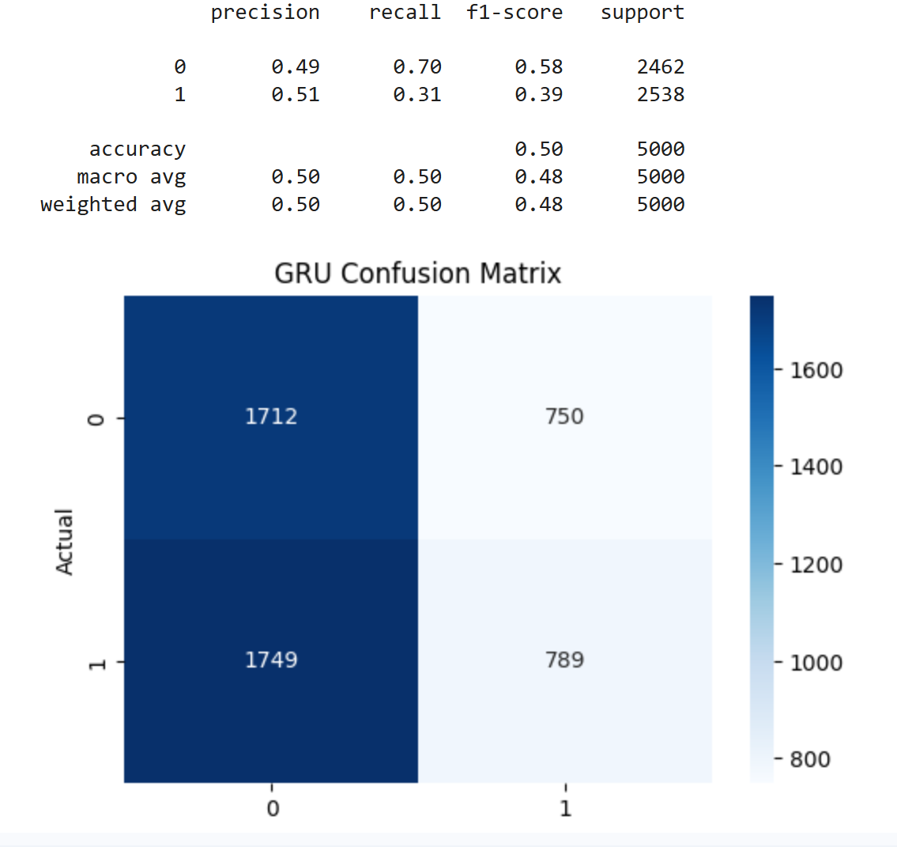
Model Building and Interpretation
GRU (Tuned)
{'model_name': 'GRU_tuned', 'best_epoch': 2, 'best_val_loss': 0.6910777688026428, 'best_val_accuracy': 0.5153999924659729, 'units': 32, 'dropout': 0.2, 'dense_units': 64, 'learning_rate': 0.001}

Slide 19
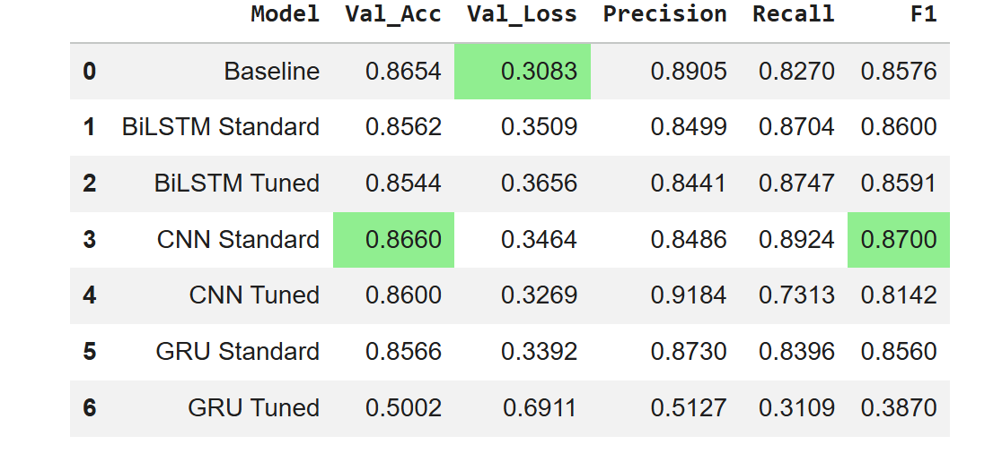
Model Summary
Analysis

Slide 20
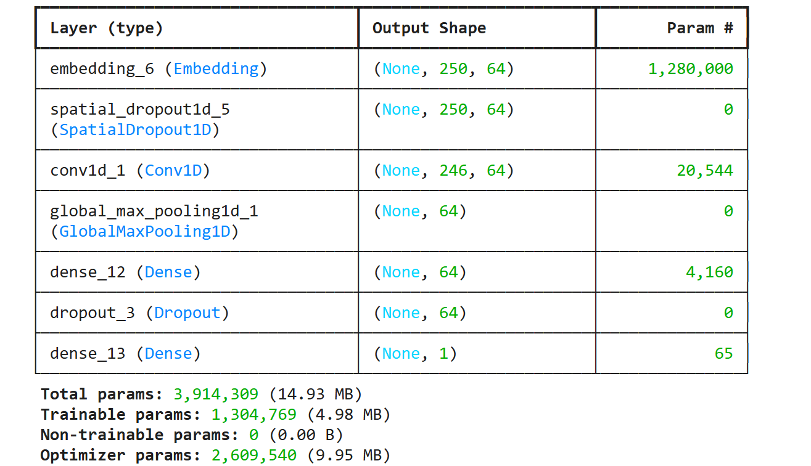
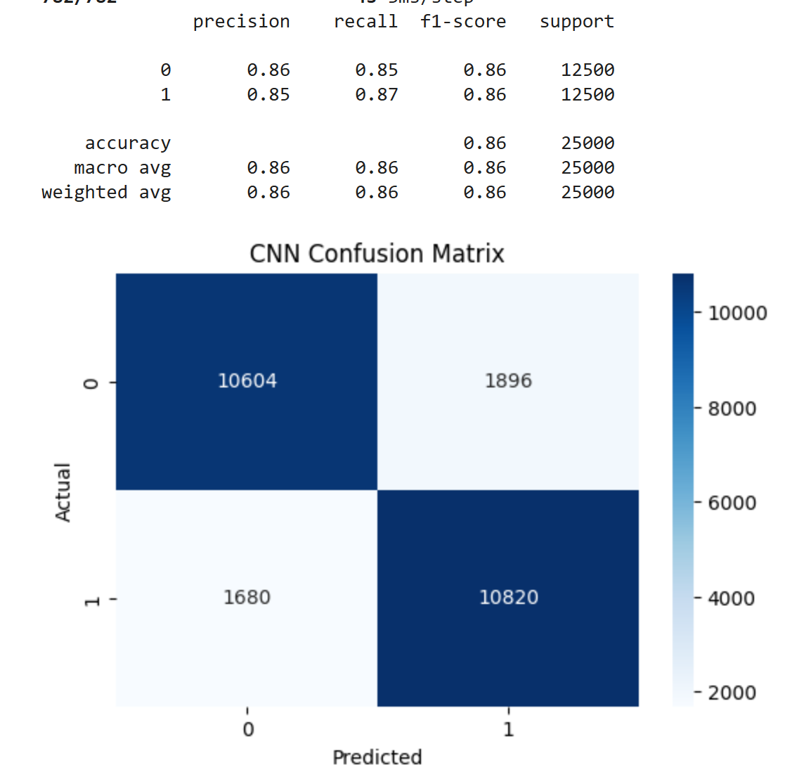
Conclusion
Best Model - CNN Standard

Slide 21
Things to Improve
Explore advanced text preprocessing techniques such as lemmatization or stemming instead of relying solely on lowercasing and punctuation removal.
Retain sentiment‑bearing punctuation like “!” and “?” since they can strengthen emotional cues in the text.
Experiment with additional high‑performing architectures, including Transformer‑based models such as BERT and other encoder‑only models.
Increase the number of training trials and epochs to allow models more opportunity to converge and improve performance.
Tune hyperparameters more extensively, including dropout rates, number of filters, and learning rates, to reduce overfitting and enhance generalization.

Slide 22
References
https://www.geeksforgeeks.org/nlp/n-gram-in-nlp/
https://www.geeksforgeeks.org/deep-learning/keras-tuner-for-hyperparameter-optimization/
https://www.numberanalytics.com/blog/gru-text-classification
https://www.tensorflow.org/api_docs/python/tf/keras/layers/GRU
https://keras.io/api/layers/convolution_layers/convolution1d/
TensorFlow Hub. (n.d.). BERT uncased English preprocessing model. https://tfhub.dev/tensorflow/bert_en_uncased_preprocess/3
TensorFlow Hub. (n.d.). Small BERT: Uncased L-4 H-512 A-8. https://tfhub.dev/tensorflow/small_bert/bert_en_uncased_L-4_H-512_A-8/1
Devlin, J., Chang, M.‑W., Lee, K., & Toutanova, K. (2019). BERT: Pre‑training of deep bidirectional transformers for language understanding. Proceedings of NAACL‑HLT. https://arxiv.org/abs/1810.04805
Tensorflow: Abadi, M., et al. (2016). TensorFlow: Large‑scale machine learning on heterogeneous systems. https://www.tensorflow.org/
TensorFlow Text. (n.d.). https://www.tensorflow.org/text

Slide 23
Challenges
One of the major Challenges I faced in this project was the lack of consistent access to TPU or GPU resources.As a result, the model had to run primarily on CPU, which significantly increased the execution time and slowed down the overall process.

Slide 24
Links
The deliverables for Unsupervised Learning project can be found below:
Video Link :
https://youtu.be/k-8KcPKCzsY
GitHub Repository:
https://github.com/kmadhu181090/MS-AI/tree/main/Pathway%20Machine%20Learning%3A%20Theory%20%26%20Hands-On%20Practice%20with%20Python%20Specialization/CSCA%205642%3A%20Introduction%20to%20Deep%20Learning

Slide 25
Thank You

